Slide 1
HTTP requests

Slide 2
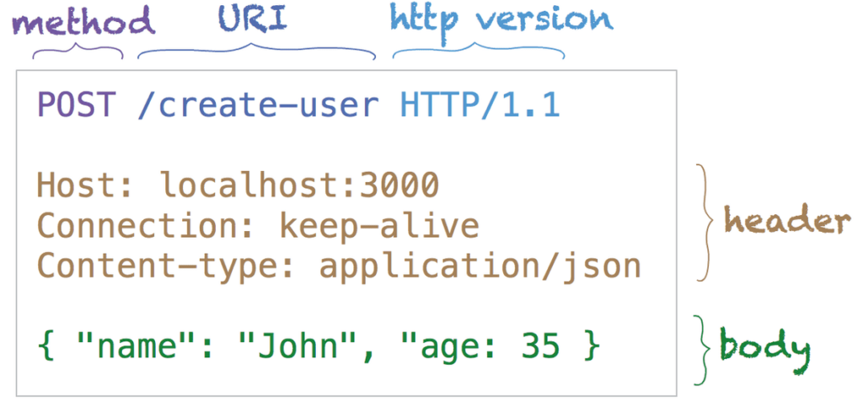
HTTP requests
An HTTP request is made by a client, to a named host, which is located on a server. The aim of the request is to access a resource on the server.

Slide 3
GET
Use GET requests to retrieve resource representation/information only – and not to modify it in any way.
As GET requests do not change the state of the resource, these are said to be safe methods.
GET APIs should be idempotent
Notes:
Idempotent: Making multiple identical requests must produce the same result every time until another API (POST or PUT) has changed the state of the resource on the server.

Slide 4
POST
POST methods are used to create a new resource into the collection of resources.
POST is neither safe nor idempotent, and invoking two identical POST requests will result in two different resources containing the same information (except resource ids).

Slide 5
PUT
Use PUT APIs primarily to update an existing resource (if the resource does not exist, then API may decide to create a new resource or not).
If a new resource has been created by the PUT API, the origin server MUST inform the user agent via the HTTP response code 201 (Created) response
If an existing resource is modified, either the 200 (OK) or 204 (No Content) response codes SHOULD be sent to indicate successful completion of the request.

Slide 6
DELETE
DELETE APIs are used to delete resources
A successful response of DELETE requests SHOULD be an HTTP response code 200 (OK) if the response includes an entity describing the status, 202 (Accepted) if the action has been queued, or 204 (No Content) if the action has been performed but the response does not include an entity.

Slide 7
HTTP Status codes
1xx – Informational
2xx – Success
3xx – Redirection
4xx – Client error
5xx – Server error

Slide 8
2xx – Success
200 – OK
201 – Created
202 – Accepted
204 – No content

Slide 9
3xx – Redirection
301 – Moved permanently
304 – Not modified

Slide 10
4xx – Client error
400 – Bad request
401 – Unauthorized
403 – Forbidden
404 – Not found
405 – Method not allowed
409 – Conflict
412 – Precondition failed
429 – Too many requests

Slide 11
5xx – Server error
500 – Internal server error
503 – Service unavailable

Slide 12
React and HTTP

Slide 13
React and HTTP
Where in the component lifecycle should I make an AJAX call?
You should populate data with AJAX calls in the componentDidMount lifecycle method. This is so you can use setState to update your component when the data is retrieved.

Slide 14
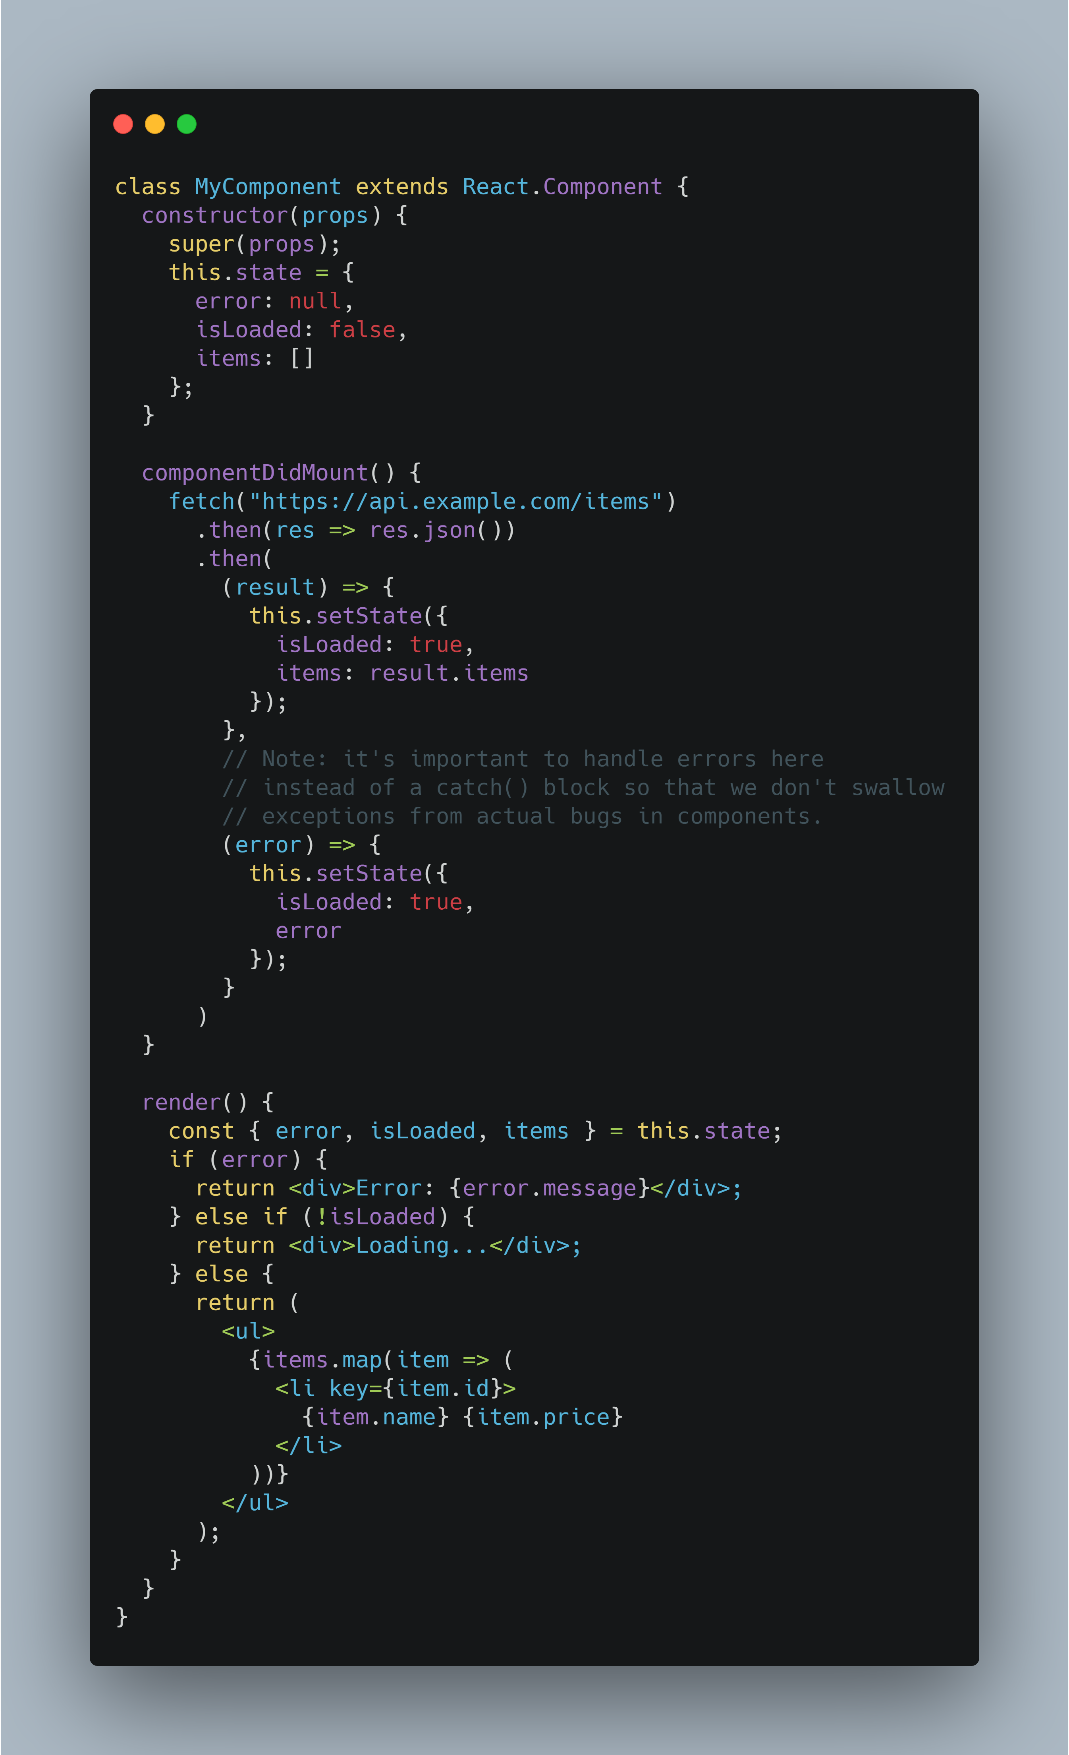
Example using the Fetch API in a class component.

Slide 15
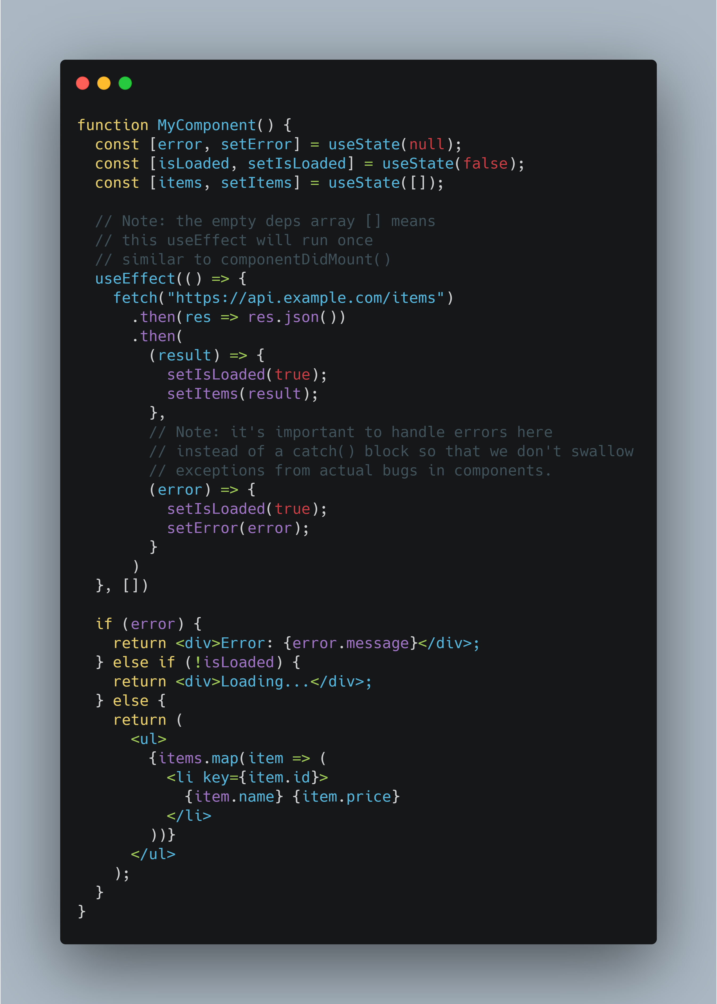
Example using the Fetch API in a functional component.

Slide 16
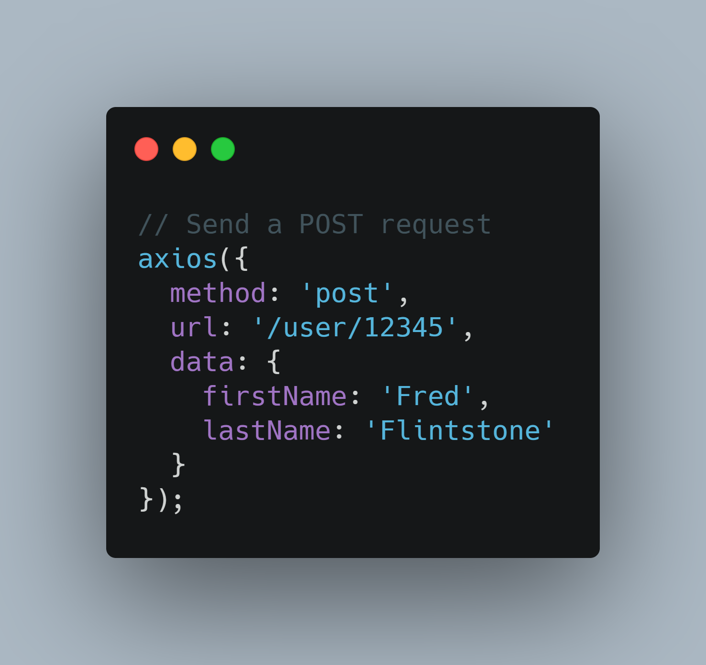
Axios library
Requests can be made by passing the relevant config to axios.

Slide 17
Axios configuration
Read https://axios-http.com/docs/req_config for more info on how to configure an axios instance to make requests.

Slide 18
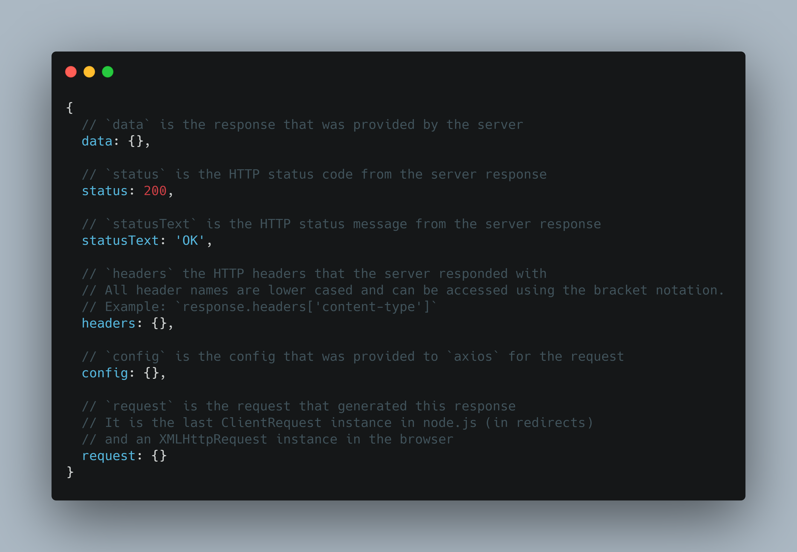
Response schema

Slide 19
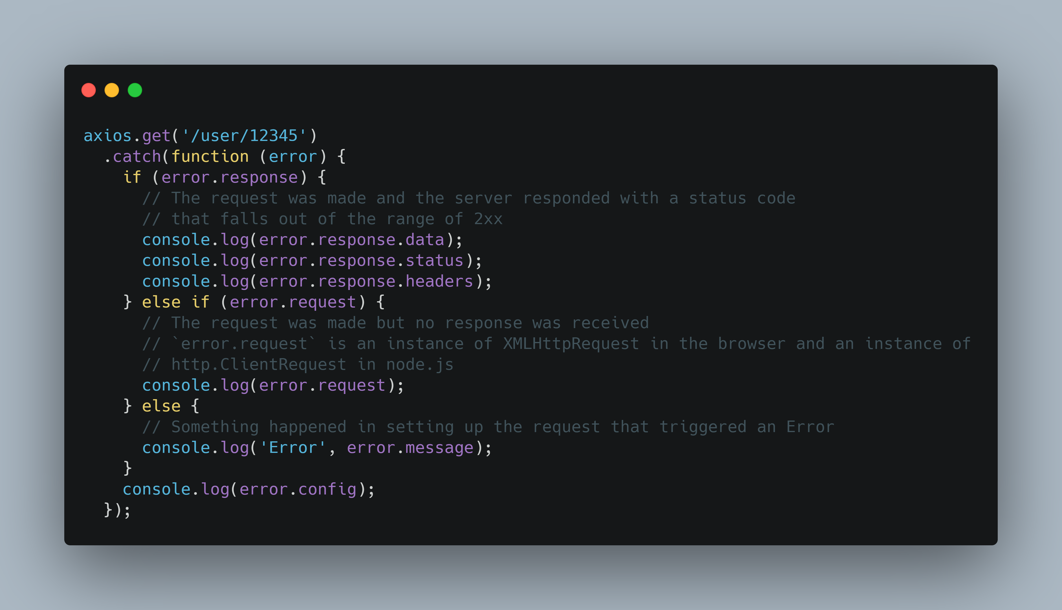
Error handling

Slide 20
Interceptors

Slide 21
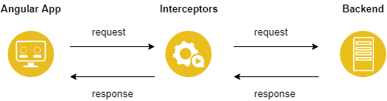
How it looks like

Slide 22
Request interceptors
Loader
Logging
Header insertion (Authentication, API Keys, XSRF, etc)
Notes:
Loader. Useful to display loading indicators (spinners, loading/status bars, etc)

Slide 23
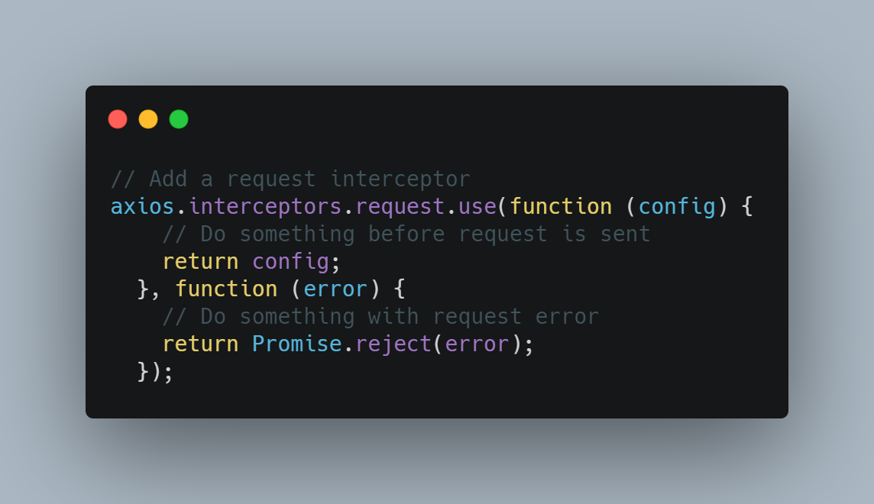

Slide 24
Response interceptors
Notifications
Logging
Resilience (retry, circuit breaker, timeout, etc)

Slide 25
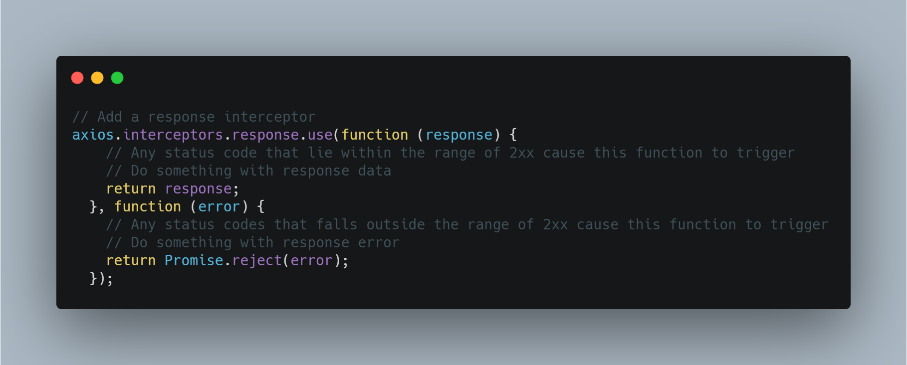

Slide 26
Libraries and built-in APIs
XMLHttpRequest
Fetch API
Axios
Unfetch
jQuery AJAX
Superagent
Use-http

